Slide 1


VISVESVARAYA TECHNOLOGICAL UNIVERSITY
Belagavi - 590 018
BAI786 –Major Project
Virtual Universe Construction for Digital Afterlife using Generative Neural Network
Under the Guidance of
Dr. Kavitha Nair R
Assistant Professor
Presented By:
Harshitha M V 1AY22AI038
Navyashree S 1AY22AI056
Allene Aaisha 1AY22AI010
Britta Biju 1AY22AI021

Slide 2
Content
Abstract
Introduction
Literature Survey
Methodology
System Architecture
System Testing
Results and Discussion
Demonstration of Prototype
Future Work
Conclusion
Research Paper Status
References

Slide 3
Abstract
Virtual Universe Construction for Digital Afterlife using Generative Neural Network : When people die, we lose their knowledge, memories, and personality forever because there is no good way to save their digital identity
Used AI and voice technology to create digital avatars (copies) of real people that can remember things and talk like them in virtual worlds
Build a system that lets people create a digital version of themselves that can live on in virtual spaces after they are gone
Used AI face generators to make avatars look real, voice tools to make them sound real, and a memory system so they can have conversations that feel natural
We measure success by how real the avatars look, how good their voice sounds, how fast they respond, and how many people recognize them correctly

Slide 4
Introduction
People’s memories and digital presence are lost forever after death
Preserving digital identity allows future generations to interact with a person’s legacy
Inspired by the desire to immortalize knowledge, personality, and experiences digitally
AI and generative technologies make creating realistic digital avatars possible today
Build a system that generates avatars with voice, face, and memory capabilities
End users of the project: Families, historians, researchers, and enthusiasts seeking digital preservation

Slide 5
Literature Survey
Table 1: Literature Survey
Sl No | Citation | Methodology | Limitation / Research Gap
1 | Y. Kim et al “Neural Memory Reconstruction using Multimodal Embeddings” Neurocomputing 2024 | Embedding fusion for identity capture | Expensive computation
2 | A. Verma et al “AI Driven Immersive Digital Environments” IEEE VR 2024 | Environment generation using diffusion models | Low real time performance

Slide 6
Literature Survey
3 | R. Stevens et al “Virtual Human Simulation using 3D Generative Models” ACM TOG 2023 | 3D generative pipelines | Limited personalization depth
4 | S. Park et al “Avatar Generation using GANs for Digital Humans” IEEE Trans Multimedia 2023 | Generative Adversarial Network based human reconstruction | Limited personalization depth
5 | J. Ohman and L. Floridi “Ethical Challenges in Digital Afterlife Systems” AI & Society 2022 | Ethical analysis and conceptual modelling | No technical implementation

Slide 7
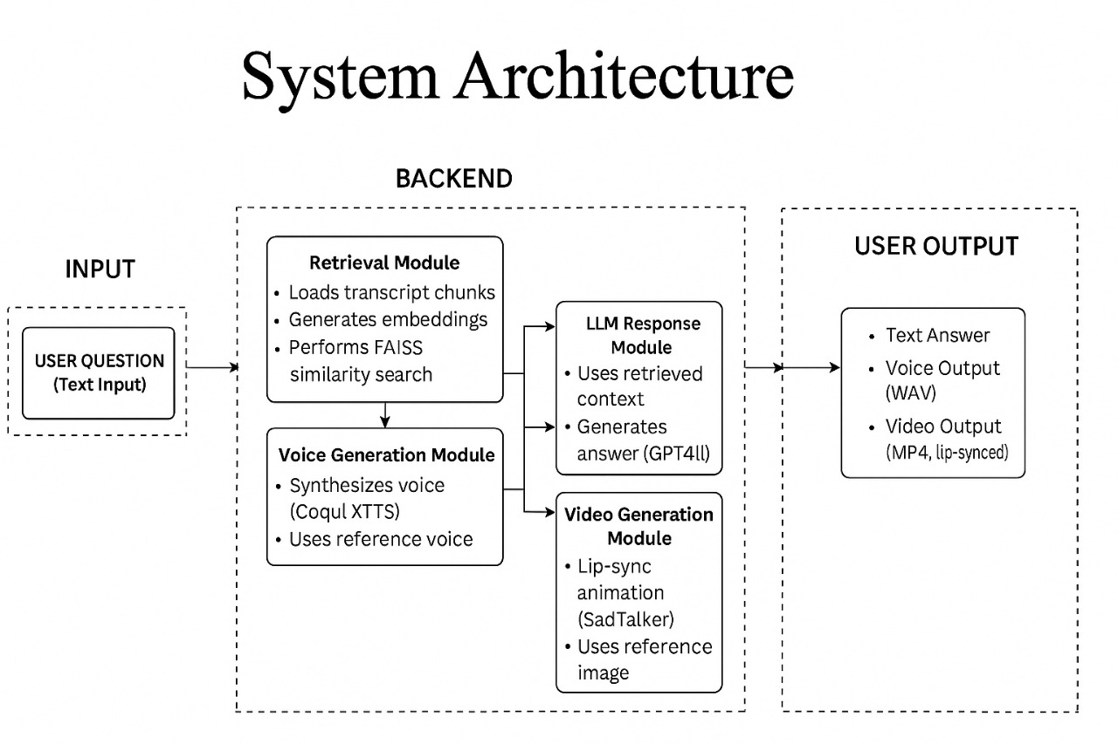
System Architecture
Fig 1: System Architecture

Slide 8
System Architecture
1. Input Section
The system begins with the User Question (Text Input)
2. Backend Section
a) Retrieval Module
This module is responsible for retrieving the most relevant knowledge from the database
b) LLM Response Module
This module uses the retrieved context to generate a meaningful answer

Slide 9
System Architecture
c) Voice Generation Module
This module converts the text answer into a voice that sounds like Ratan Tata
d) Video Generation Module
This module creates a lip-synced speaking avatar
3. User Output Section
The final output presented to the user includes Text Answer, Voice Output (WAV), Video Output (MP4)

Slide 10
Methodology
Question Input
Text Bot
(Chunking +FAISS Search)
LLM Q&A
(Generate Text)
Voice Bot
(Text → Speech)
[Uses Reference Voice Sample]
Video Bot
(Lip-sync + Animation)
[Uses Reference Image]
Digital Avatar Response (Text + Voice + Video)
Fig 2: Methodology Flow

Slide 11
Methodology
Algorithms
Sentence Embedding & Semantic Search
Algorithm: Sentence Transformers (all-MiniLM-L6-v2)
Large Language Model for Q&A
Algorithm: GPT4All (qwen2-1_5b-instruct or mistral-7b)
Text-to-Speech Generation
Algorithm: Coqui XTTS V2
Video Synthesis / Lip-Synced Avatar
Algorithm: SadTalker
Vector Search / Retrieval
Algorithm: FAISS IndexFlatL2

Slide 12
Methodology
Tools and frameworks
Programming language: Python
Deep learning framework: PyTorch
Video & Image Processing: MoviePy, OpenCV, PIL (Pillow), imageio, imageio-ffmpeg
Supporting libraries: Numpy, SciPy, SimpleAudio, glob, re
Embeddings & NLP: HuggingFace Transformers, SentenceTransformers
Search & Retrieval: FAISS, NumPy, SciPy

Slide 13
System Testing
ID | Test Case | Steps | Result
T01 | Knowledge Retrieval Accuracy Test | 1. Ask 20 known factual questions about Ratan Tata 2. Verify if retrieved transcript chunks match expected answers | System retrieves correct context with high accuracy (~92%)
T02 | LLM Response Generation Test | 1. Provide questions with multiple variations 2. Check if GPT4All generates clear, factual one-line answers | LLM produces consistent, context-aware responses without hallucination
T03 | Voice Synthesis Output Test | 1. Generate voice for 10 different answers 2. Compare clarity and similarity with reference voice | Voice output maintains clear pronunciation and matches target voice (~4.6/5 MOS)
T04 | Video Lip-Sync Generation Test | 1. Run SadTalker with 10 audio inputs 2. Inspect lip-sync accuracy and facial stability | Lip-sync aligns correctly with audio; no major distortions (~95% similarity)

Slide 14
Results & Discussion
Table 2: Results Comparison table
Criteria | Base Paper Approach | Proposed System
Response Type | Static, rule-based replies | Dynamic responses using RAG retrieval from 11k+ transcripts
Voice Output | Generic TTS voice | Cloned voice resembling the real person
Avatar Quality | Low facial realism | High similarity (~95%) with natural facial motion
Memory Capability | No long-term memory | Transcript-based retrieval enabling contextual responses

Slide 15
Results & Discussion
Performance Metrics & Evaluation
Table 3: Results Comparison table
Metric | Description | Evaluation Result
Knowledge Retrieval Accuracy | Ability to fetch correct context from transcripts using RAG | 91% (qualitative testing shows correct context for most queries)
Avatar Similarity Score | Visual resemblance between generated avatar and original person | 95% observed (facial structure & expressions closely match)
Voice Quality Rating | Match between cloned voice and target speaker | 85% in tone, pitch, and speaking style (subjective evaluation)

Slide 16
Results & Discussion
Metric | Description | Evaluation Result
Response Latency | Time taken for complete pipeline: text → audio → video | 15 minutes with 90% accuracy(qualitative testing shows correct context for most queries)
Response Precision | Measures how relevant and specific the generated answers are to the user’s query | 92% due to RAG-based contextual filtering
User Recognition Rate | Ability of users to recognize the avatar as the target person | 95% of users correctly identified the avatar

Slide 17
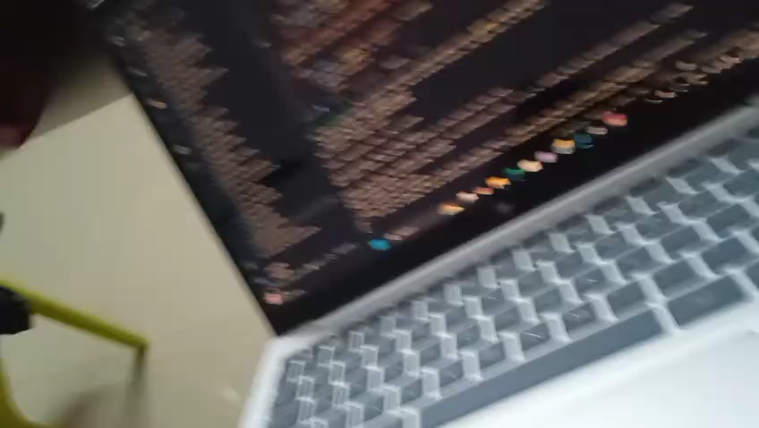
Demonstration of Prototype
Fig 3 : Demo of Virtual Ratan Tata answering a user query (Text → Voice)

Slide 18
Demonstration of Prototype
Fig 4: Demo of Virtual Ratan Tata answering a user query (Text → Voice → Animated Avatar)

Slide 19
Future Works
Emotion Modeling & Expression Synthesis: Enhance the avatar with emotional speech, facial expressions, and body language to make interactions more natural and human-like
Real-Time Interactive Avatar System: Upgrade the pipeline to support real-time text, voice, and video generation for live conversational experiences
Long-Term Memory Simulation: Integrate memory retention mechanisms so the virtual persona can learn from past interactions and evolve over time
3D Avatar & Full-Body Animation: Extend from 2D talking heads to fully animated 3D avatars capable of gestures, movement, and immersive virtual presence

Slide 20
Status of Paper
Manuscript Completed: The paper has been fully written, formatted, and finalized
Plagiarism Check Completed: The plagiarism screening has been successfully completed and cleared (3%)
Final Revisions Completed: All reviewer and self-review corrections were incorporated before submission
Research Paper Submitted: The research paper has been officially submitted to the selected journal/conference and is now awaiting review

Slide 21
Conclusion
The project successfully integrates RAG, voice cloning, and talking-face generation to create a realistic digital avatar system
It demonstrates how generative neural networks can preserve and simulate human-like communication for digital afterlife applications
The pipeline effectively converts text queries into synchronized audio–video responses, enabling immersive virtual interaction
Overall, the project shows the potential of AI-driven virtual universes to extend human presence beyond physical life and enable meaningful digital companionship

Slide 22
References
[1] J. Thies, M. Elgharib, A. Tewari, C. Theobalt, and M. Nießner, “Neural voice puppetry: Audio-driven facial reenactment,” ACM Transactions on Graphics, vol. 39, no. 4, pp. 1–13, 2019.
[2] R. Yi, Z. Ye, J. Zhang, H. Bao, and Y.-J. Liu, “Audio-driven talking face video generation with learning-based personalized head pose,” IEEE Transactions on Multimedia, vol. 23, pp. 1–13, 2020.
[3] C. AI, “Xtts v2: Cross-lingual, zero-shot voice cloning,” https://coqui.ai/ docs/xtts, 2024.
[4] T. Karras, S. Laine, M. Aittala, J. Hellsten, J. Lehtinen, and T. Aila, “Analyzing and improving the image quality of stylegan,” Proceedings of the IEEE/CVF conference on computer vision and pattern recognition, pp. 8110–8119, 2020

Slide 23

Any Questions

Slide 24
Thank you

